Slide 1

D3.js
CMPT 384 – Information Visualization
Lab 5
Course Instructor: Debajyoti Mondal
Lab Tutorial Instructor : Arman Heydari( arman.heydari@usask.ca )

Slide 2
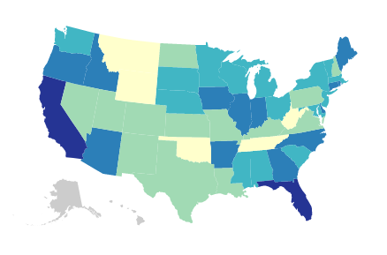
Agenda
D3 Path
D3 Generator (line)
D3 Scale (Quantize)
D3 Geographic Maps
D3 Geo Projection
Path Generator

Slide 3
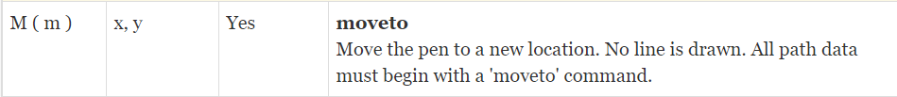
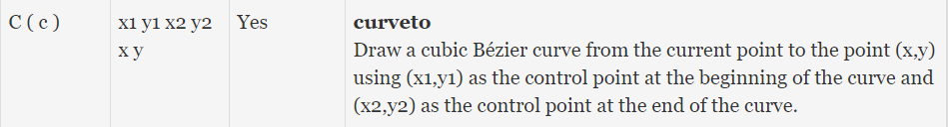
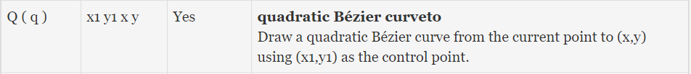
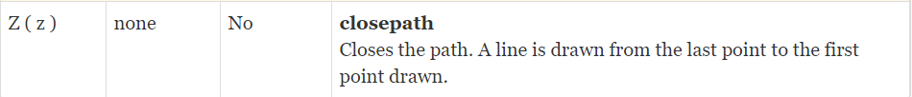
D3 Path
Path tag and d attribute
<path d="M 10 25 L 10 75 L 60 75 L 10 25"></path>

Slide 4
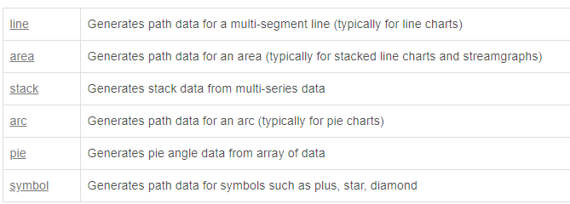

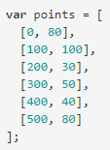
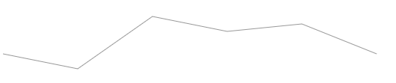


D3 Generator

Slide 5

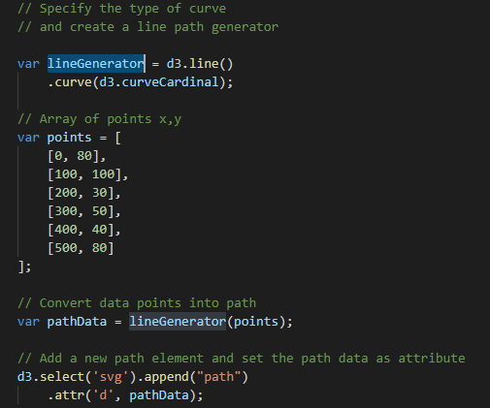

D3 Path – example 1 Line generator
d3.curveCardinal
d3.curveNatural
d3.curveBasis
d3.curveStep

Slide 6
D3 Scales – Quantize Scale
var bucket = d3.scaleQuantize() .domain([0, 1])
.range([‘A’, ‘B’, ‘C’])
A
B
C
>> bucket(0.25)
>> ‘A’
>> bucket(0.75)
>> ‘C’
0-0.33
0.33-0.66
0.66 – 1.00

Slide 7
D3 Geographic Maps
Declare a map projection (https://github.com/d3/d3-geo-projection)
Define geo-path generator
Read geoJSON file
Map data with geoJSON
Set geo-path in ‘d’ attribute of ‘path’
US Agri Productivity
https://www.data.gov/

Slide 8
Finding the Right GEOJSON
LIST OF MOST NORTH AMERICAN CITIES AND PROVINCES -
https://github.com/codeforamerica/click_that_hood/tree/master/public/data
CONVERT PUBLICLY AVAILABLE SHAPE FILES INTO GEOJSON -
http://geojson.io/#map=2/20.0/0.0
Finding the Right Data
OPEN-DATA Websites –
http://www.opendatask.ca/data/ - Curated List of all data on saskatoon available for free
http://opendata-saskatoon.cloudapp.net/ - Catalogue of Saskatoon open data
https://data.calgary.ca/ - Calgary open data

Slide 9
Start the server
Microsoft Windows [Version 10.0.15063]
(c) 2017 Microsoft Corporation. All rights reserved.
C:\> python -m SimpleHTTPServer 8888
C:\Users\jyoti\AppData\Local\Programs\Python\Python37-32\python.exe: No module named SimpleHTTPServer
C:\> python -m http.server 8888
Serving HTTP on 0.0.0.0 port 8888 (http://0.0.0.0:8888/) ...

Slide 10
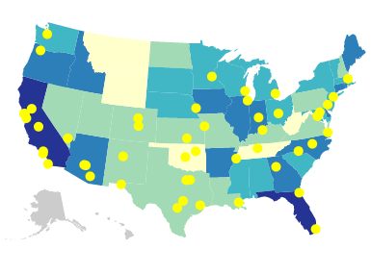
Try this -
Try to create a visualization like the below with the help of us-cities.csv
Hint : You can get the pixel position for the cities by passing latitude and longitude to the projection
Answer is here: example_4_cities.html

